Slide 1
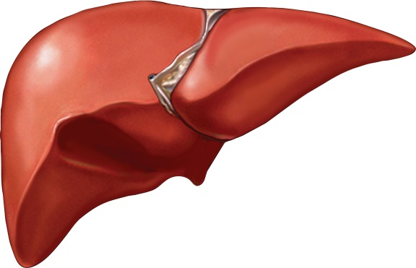
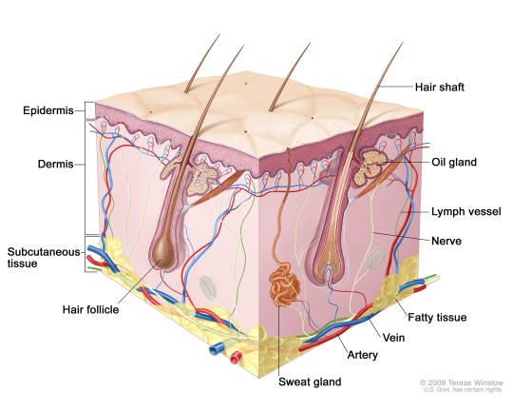
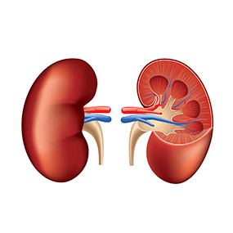
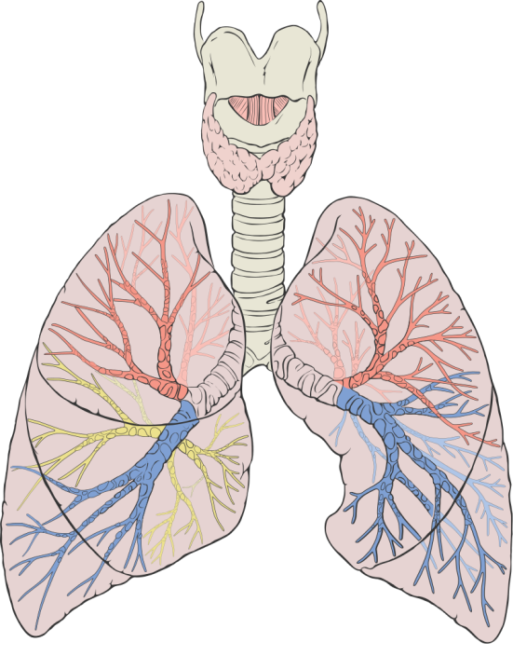
Excretory system

Slide 2
Excretory system
Regulator of the chemical composition of bodily fluids via the removal of wastes and retainment of proper amounts of water, salts and nutrients

Slide 3
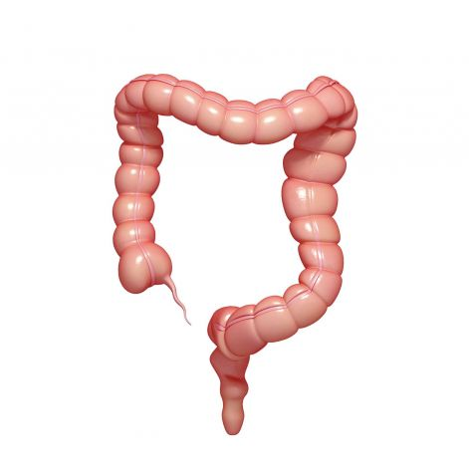
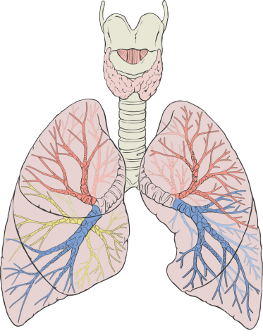
Excretion vs. elimination
Excretion | Elimination
The removal of metabolic waste products from the body | The removal of indigestible foods from the body
Notes:
Students firstly have a discussion of what the difference is between excretion and elimination. Then they need to copy the definitions.
Diagram 1: Represents Carbon dioxide that is produced via cellular respiration being expelled by the lungs.
Diagram 2: Any food that has not been digested passes straight through the bosy (No metabolism occurs)

Slide 4
Organ | Involvement in the excretory system
Notes:
Page 123 of Human Perspectives book

Slide 5

Liver functions
Deamination
Detoxifies chemicals
Creates bile
Stores excess energy sources
Creates proteins that help clot blood
Notes:
Deamination is the main process in the liver involved with excretion

Slide 6
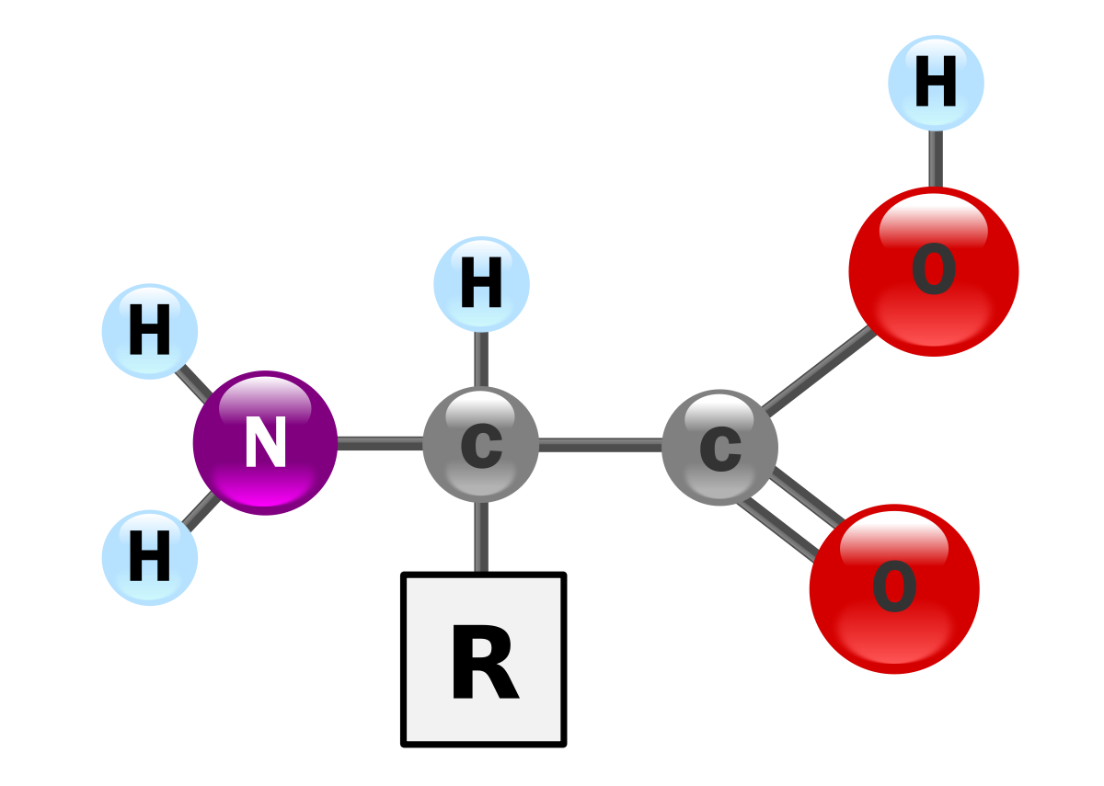
Deamination
The removal of an amino group from a molecule

Slide 7
7.2 The liver and skin
Deamination
The liver is located in the upper abdominal cavity.
It is a very large organ with a host of different functions, one of which is the preparation of materials for excretion.
The liver plays an important role in processing chemicals into a safer form. For example, it converts ammonia produced from proteins into the safer form of urea by a process called deamination.
Deamination uses enzymes to remove the amino group (NH₂) from the amino acids. Once the amino group has been removed, it is converted by the liver cells to ammonia (NH₃) and then finally to urea, where it is eliminated from the body in urine.
The remaining part of the amino acid, which is mainly carbon and hydrogen, is converted into a carbohydrate that can be readily broken down by the cells to release energy, carbon dioxide and water.

Slide 8
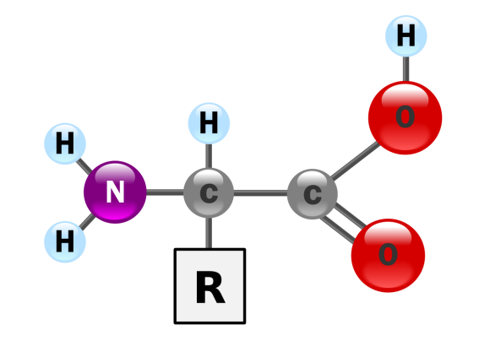
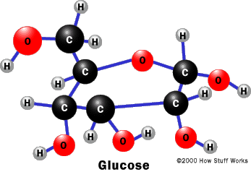
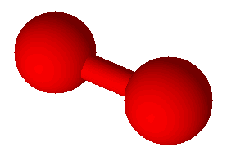

Deamination
Amino acid + Oxygen → Carbohydrate + Ammonia
O
O
Used for energy
Toxic

Slide 9

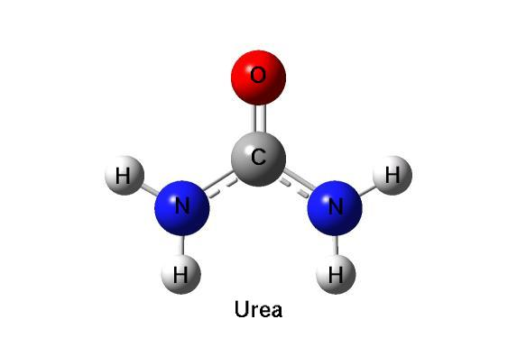
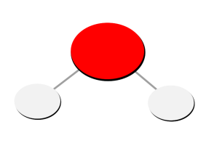
How to get rid of toxic ammonia?
Carbon dioxide + Ammonia → Urea + water
O
H
H
Taken from the liver to the kidney to be filtered and excreted

Slide 10
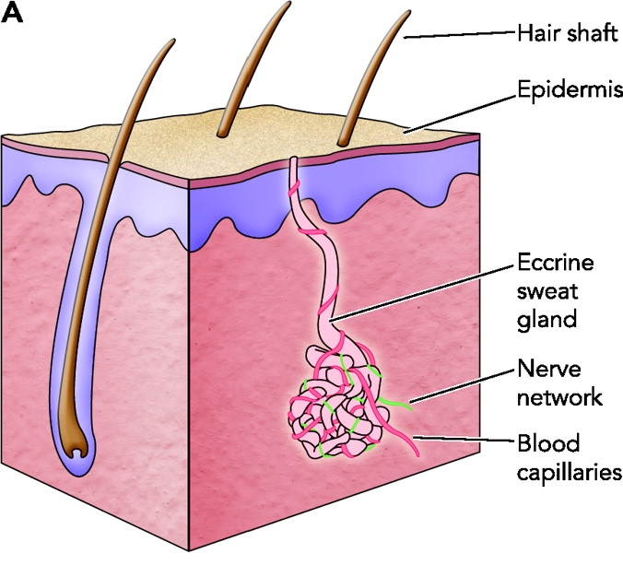
Skin
Although the skins main function is to provide a protective covering, it is also involved in excretion
Dissolved salt, lactic acid & urea can exit the body via sweat glands

Slide 11
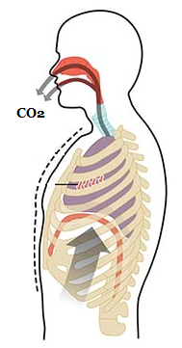
Lungs
Carbon dioxide is a by-product of cellular respiration and can be toxic if it accumulates in the body
The lungs help to expel this

Slide 12
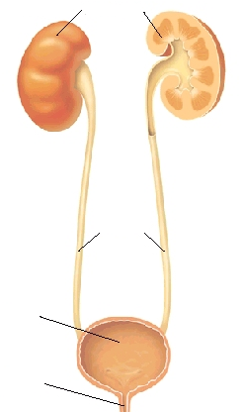
Kidney
The kidneys, bladder and their associated ducts are collectively known as the urinary system

